Slide 1
컴퓨터 네트워크 Computer Networks and Internets, 6e

Slide 2
TCP: Reliable Transport Service

Slide 3
Assignment
Choose all features of TCP.
① Message Interface ② Connection-oriented ③ simplex
④ best effort ⑤ retransmission ⑥ end-to-end
2. Show the growth of window size caused by slow start and congestion control.
3. Which of UDP and TCP is better for the communication between DNS server and client. (consists of two packets - DNS request, DNS reply)
4. Find an item which is caused by the packet loss.
① retransmission ② ACK ③ delayed ACK
④ congestion avoidance ⑤ larger window size ⑥ flow control
Send your solution to me by email. (Due date: Sat. /24PM)
This assignment will be used to check your attendance.
© Pearson Education Inc., Upper Saddle River, NJ. All rights reserved.
3
Notes:
3

Slide 4
Full-Duplex Communication
TCP connection between A and B provides two independent data streams, one from A to B and the other from B to A
Each side
Has a receive buffer
Advertises a window size for incoming data
Uses sequence numbers to number outgoing data bytes
Implements timeout-and-retransmission for data it sends
Application can choose to shut down communication in one direction
Each TCP packet contains fields for both forward and reverse data streams
Sequence number for data being sent in the forward direction
Acknowledgement number for data that has been received
© Pearson Education Inc., Upper Saddle River, NJ. All rights reserved.
4
Notes:
4

Slide 5
Stream Interface
After connection is established, TCP accepts a stream of data bytes from the sending application and transfers them
Sending application can choose amount of data to pass on each request
Surprise: TCP decides how to group bytes into packets
Known as stream interface
Data may be passed to a receiving application in chunks that differ from the chunks that the sending application generated.
© Pearson Education Inc., Upper Saddle River, NJ. All rights reserved.
5
Notes:
5

Slide 6
TCP's Three-Way Handshake
To establish or terminate connections reliably
TCP uses a 3-way handshake
During the 3-way handshake to start a connection
each side sends a control message that specifies an initial buffer size (for flow control) and a sequence number
TCP's 3-way exchange is necessary and sufficient to ensure unambiguous agreement
despite packet loss, duplication, delay, and replay events
The handshake insures that TCP will not open or close a connection until both ends have agreed

Slide 7
TCP's Three-Way Handshake
Term synchronization segment (SYN segment) to describe the control messages used in a 3-way handshake to create a connection
Term FIN segment (short for finish segment) to describe control messages used in a 3-way handshake to close a connection
Figure 26.8 illustrates the 3-way handshake to create a connection
A key aspect of the 3-way handshake is the selection of sequence numbers
TCP requires each end to generate a random 32-bit sequence number that becomes the initial sequence
© Pearson Education Inc., Upper Saddle River, NJ. All rights reserved.
7
Notes:
7

Slide 8
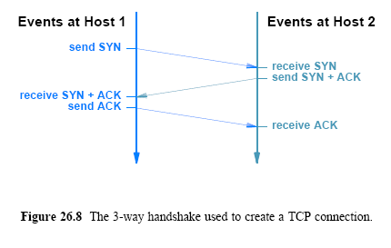
TCP's Three-Way Handshake Connection Establishment

Slide 9
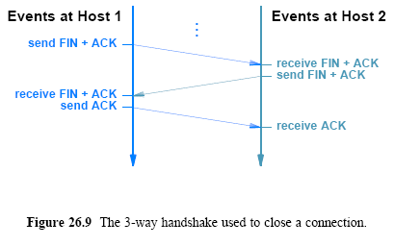
TCP's Three-Way Handshake Connection Termination

Slide 10
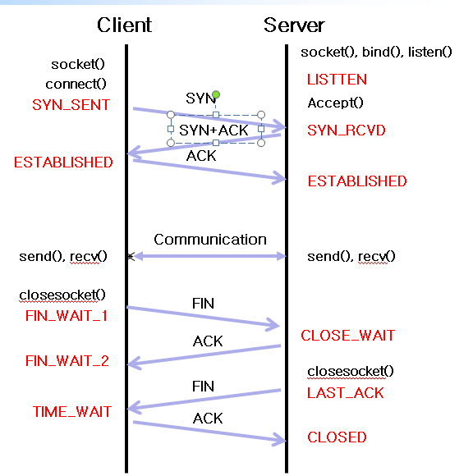
State of TCP Connection(RFC 793.)
A TCP connection progresses through a series of states during its lifetime.
The possible states are as follows:
LISTEN, SYN-SENT, SYNRECEIVED, ESTABLISHED,
FIN-WAIT-1, FIN-WAIT-2,
CLOSE-WAIT, CLOSING,
LAST-ACK, TIME-WAIT
the fictional state is CLOSED.

Slide 11
TCP Segment Format
TCP uses a single format for all messages
including messages that carry data, those that carry ACKs, and messages that are part of the 3-way handshake used to create or terminate a connection (SYN and FIN)
TCP uses the term segment to refer to a message
Figure 26.10 illustrates the TCP segment format
A TCP connection contains two streams of data
one flowing in each direction
If the applications at each end are sending data simultaneously
TCP can send a single segment that carries outgoing data
The ACK for incoming data, and a window advertisement that specifies the amount of additional buffer space available for incoming data
Some of the fields in the segment refer to the data stream traveling in the forward direction
while other fields refer to the data stream traveling in the reverse direction

Slide 12
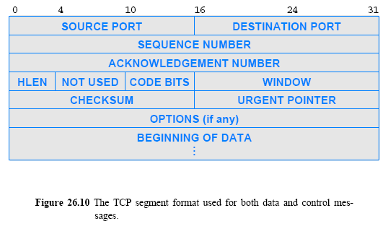
TCP Segment Format

Slide 13
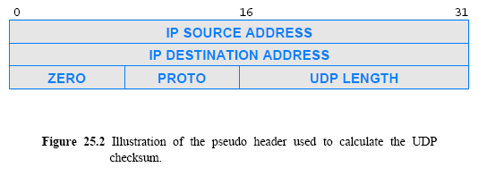
The UDP Checksum and the Pseudo Header

Slide 14
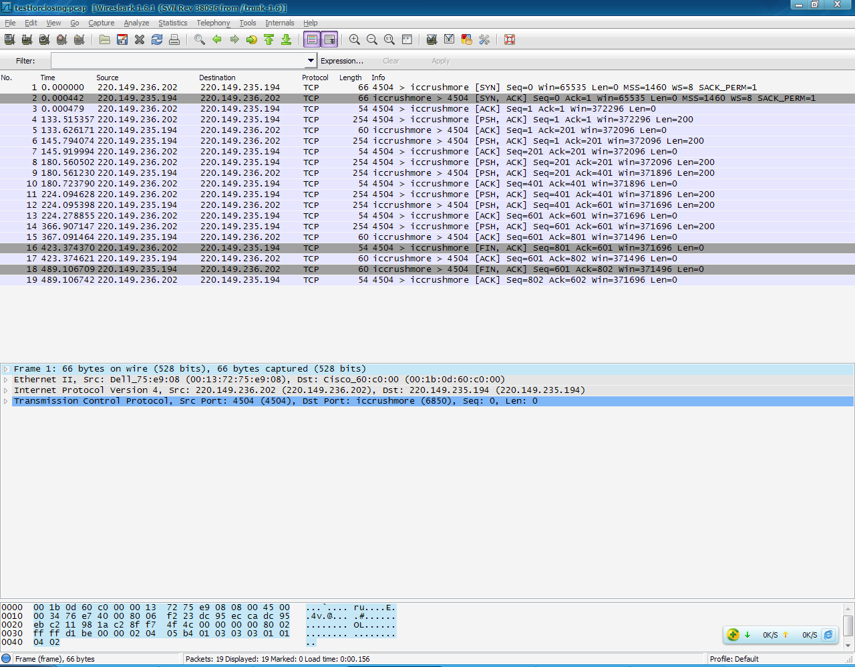
Analysis of Example
Wireshark’s output

Slide 18
The Client-Server Model of Interaction
how can a pair of applications that run on two independent computers coordinate to guarantee that they request a connection at the same time?
The answer lies in a form of interaction known as the client-server model
A server starts first and awaits contact
A client starts second and initiates the connection
Application programs known as clients and servers handle all services in the Internet
Confusion exists between scientific and marketing terminology
- Scientific: a client and a server are each programs
- Marketing: a server is a powerful computer

Slide 19
Characteristics of Clients and Servers
A client software:
Is an arbitrary application program that becomes a client temporarily when remote access is needed, but also performs other computation
Is invoked directly by a user, and executes only for one session
Runs locally on a user's personal computer
Actively initiates contact with a server
Can access multiple services as needed, but usually contacts one remote server at a time
Does not require especially powerful computer hardware

Slide 20
Characteristics of Clients and Servers
A server software:
Is a special-purpose, privileged program
Is dedicated to providing one service that can handle multiple remote clients at the same time
Is invoked automatically when a system boots, and continues to execute through many sessions
Runs on a large, powerful computer
Waits passively for contact from arbitrary remote clients
Accepts contact from arbitrary clients, but offers a single service
Requires powerful hardware and a sophisticated operating system (OS)
20
Notes:
20

Slide 21
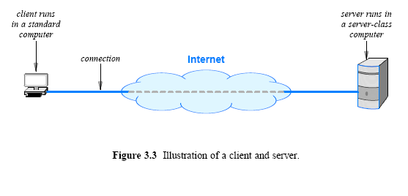
Server Programs and Server-Class Computers

Slide 22
Requests, Responses, and Direction of Data Flow
Client and server?
Which side initiates contact?
Once contact has been established, two-way communication is possible (i.e., data can flow from a client to a server or from a server to a client)
In some cases, a client sends a series of requests and the server issues a series of responses (e.g., a database client might allow a user to look up more than one item at a time)

Slide 23
Server Identification and Demultiplexing
How does a client identify a server?
The Internet protocols divide identification into two pieces:
An identifier for the computer on which a server runs
An identifier for a service on the computer
Identifying a computer?
Each computer in the Internet is assigned a unique 32-bit identifier known as an Internet Protocol address (IP address)
A client must specify the server’s IP address
To make server identification easy for humans, each computer is also assigned a name, and the Domain Name System (DNS)
described in Chapter 4 is used to translate a name into an address
Thus, a user specifies a name such as www.cisco.com rather than an integer address

Slide 24
Server Identification and Demultiplexing
Identifying a service?
Each service available in the Internet is assigned a unique 16-bit identifier known as a protocol port number (or port number)
Examples, email → port number 25, and the web → port number 80
When a server begins execution
it registers with its local OS by specifying the port number for its service
When a client contacts a remote server to request service
the request contains a port number
When a request arrives at a server
software on the server uses the port number in the request to determine which application on the server computer should handle the request
Figure summarizes the basic steps
24
Notes:
24

Slide 25
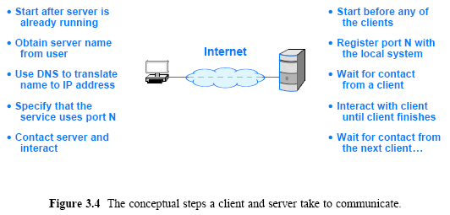
Server Identification and Demultiplexing

Slide 26
State of TCP Connection(RFC 793.)
A TCP connection progresses through a series of states during its lifetime.
The possible states are as follows:
LISTEN, SYN-SENT, SYNRECEIVED, ESTABLISHED,
FIN-WAIT-1, FIN-WAIT-2,
CLOSE-WAIT, CLOSING,
LAST-ACK, TIME-WAIT
the fictional state is CLOSED.

Slide 29
Assignment
1. In TCP, how many sequence numbers are consumed by each segments?
a. SYN b. ACK c. FIN+ACK d. ACK+data(100bytes)
2. The intruder sends a SYN segment to the server using 철수’s IP address. Can the intruder create a TCP connection with the server by pretending that he is 철수? Assume that the server uses 1) a different ISN(Initial Sequence Number) for each connection or 2) the same ISN for each connection.
3. Following is the output from netstat command.
Proto Local Address Foreign Address State
TCP 192.13.201.215:1059 0.0.0.0:* LISTEN
TCP 192.13.201.215:61032 211.234.249.226:59004 TIME_WAIT
TCP 192.13.201.215:62029 211.233.16.71:80 ESTABLISHED
1) Explain the values of state - LISTEN, ESTABLISHED, TIME_WAIT.
2) Is 192.13.201.215:1059 server or client?
3) Explain “211.233.16.71:80 “ in Foreign Address in two parts.
4. Capture various Ethernet frames using Wireshark, and explain fields in the Ethernet, IP, and TCP header.
5. Run “netstat” command, and explain the states of the process(server, client).
Send your solution to me by email. (Due date: Sat. /24PM)
This assignment will be used to check your attendance.
© Pearson Education Inc., Upper Saddle River, NJ. All rights reserved.
29
Notes:
29

